Slide 1

Welcome! Click & Learn: Civil Procedure Zoom Session
Professor Angela Upchurch
Southern Illinois University School of Law
Teaches Civil Procedure in two 3-credit semesters (1Ls and 2Ls)
Professor Susan M. Gilles
Capital University School of Law
Teaches Civil Procedure in two 3-credit semesters (1Ls, 2Ls and part-time students)
Professor Cynthia M. Ho
Loyola University Chicago School of Law
Teaches Civil Procedure in one 4-credit semester (1Ls-Fall)

Slide 2
C&L:CP is a great supplement to any Civil Pro Class
Offers maximum flexibility to the user
In-person courses
Hybrid (or partially online) courses
Fully online courses (synchronous or asynchronous)
You can easily pivot from in-person to online if needed
Many questions with varying degrees of difficulty
Meet students at their level
Ensure rigor in learning
Highly interactive, with instant feedback to student
Pairs with any traditional casebook
Either as required or recommended reading
Notes:
I used to think hybrid means part in person and part online. But, it seems that it now means part of your class in person and part online. So, that’s why I added “partially online” to the hybrid one. I don’t think C&L necessarily solves the problems people have if part of their class will be in person and part remote. But, I don’t think any does.
I also noted that in pairing, it could be required or recommended which I don’t see clearly stated in the preview slide

Slide 3

C&L can help easily meet ABA Requirements for online/distance class 306(d)
The ABA requires that any online course provide:
Regular monitoring of student effort (i.e., frequent feedback)
Regular and substantive interaction between professor and student
Regular and substantive interaction among students
Notes:
ANGELA -- Let’s be VERY short on this – let’s say that we can highlight how C&L accomplishes these as we go
If needed…here are some thoughts on each
Studetn effort monitored through completion of sections and quiz responses
Usign C&L to monitor and redirect students; covering questions students got wrong (either in live class or by posting something on class board); posting a particuarlly challenging question and asking for student input on each answer beyond what C&L says
Have students complete C&L assignment together; have students write about question on a message board; change question slightly and have students reposnin person or on message board

Slide 4
Outline for This Session
Ways to easily incorporate C&L:CP into your Civ Pro course
Preview Basics of C&L:CP
Demonstrate uses of C&L:CP
Q&A

Slide 5
Preview: Ways to incorporate C&L:CP
1
Turn-key, easy to integrate supplement
Test student understanding at the end of a topic by running higher-level application questions
Preview material outside of class by running basic introductory questions (which can also constitute ABA class minutes)
Enhance in-class learning by running higher-level application questions (or reviewing tricky concepts with basic questions), rather than writing your own
2
3
4
Notes:
I blended everyone’s comments and tried to simplify – please continue to edit
For our presentation, let’s just put these up and then go through them in more detail later. Here is the detail we will get into later, but if we get asked, I am including notes here: (NOTE – all can be done in group work or through group discussion online)
On #1: This is the easiest to go with option; You can recommend portions of C&L:CP for your students to complete on their own, at their own pace, to help them learn and reinforce concepts to achieve mastery; Use our casebook companion tables to create your assignments
On #2: Assign higher level questions at the end of a topic (or multiple topics) for review and/or assessment
On #3: Assign basic questions to have students preview or learn a concept before/outside of class time (either alone or in groups). Supports pre-recorded lectures. Can also be used to meet ABA minutes requirement for class
On #4: we can expand on ways to run a question in-class (polling options) or group work; also we can note how to select an appropriate question

Slide 6
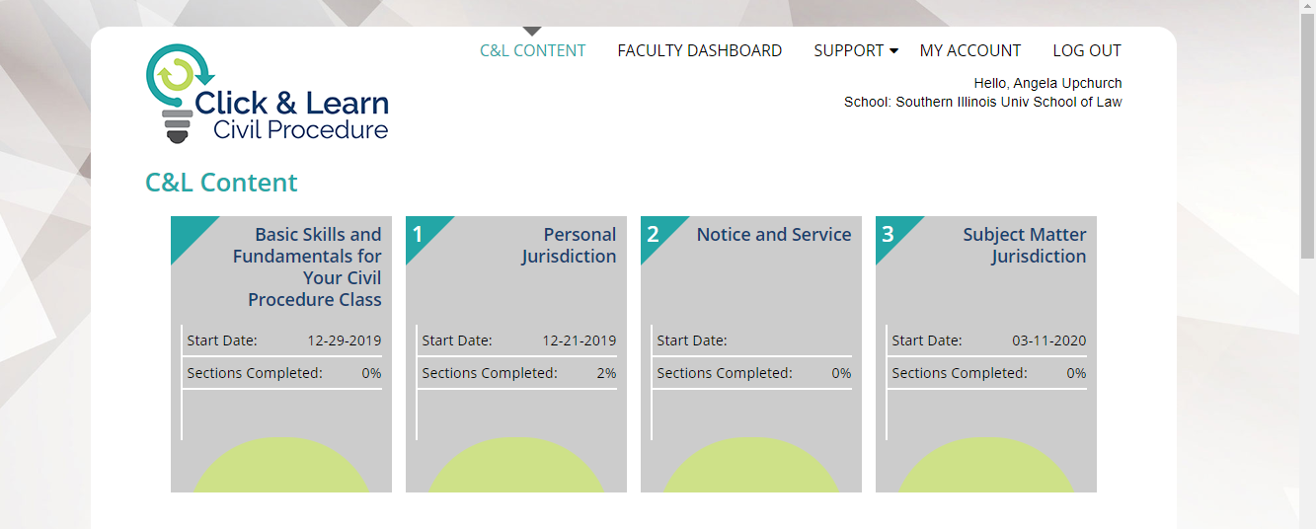
C&L:CP – An Introduction
Notes:
We should note that we will be showing some screenshots and will be using the live version too. In the screenshot they won’t see everything, e.g., this is only showing the first row, and that there are clearly other topcis

Slide 7
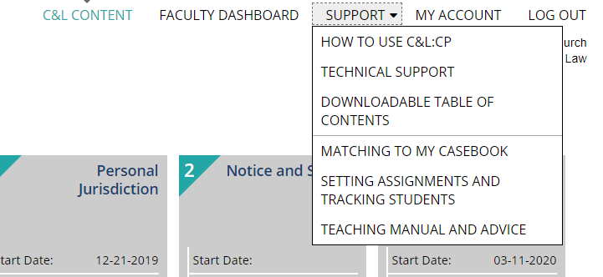
Main Choices: Supportive Tools

Slide 8
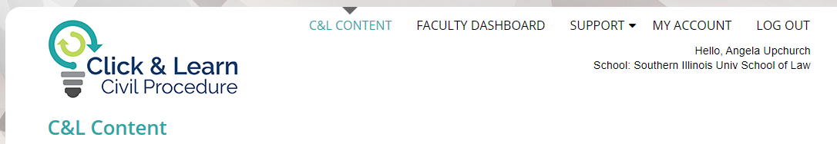
Main Choices: Viewing Content

Slide 9
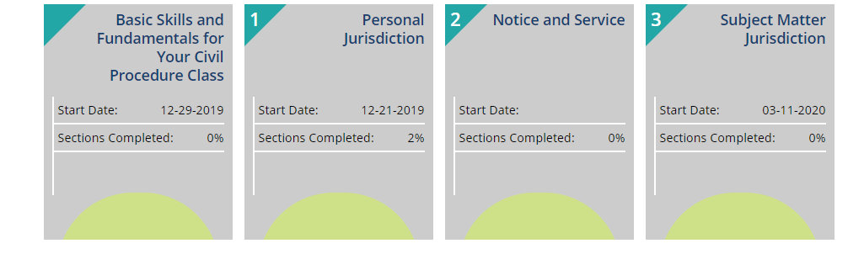
Division of C&L: CP Content Units

Slide 10
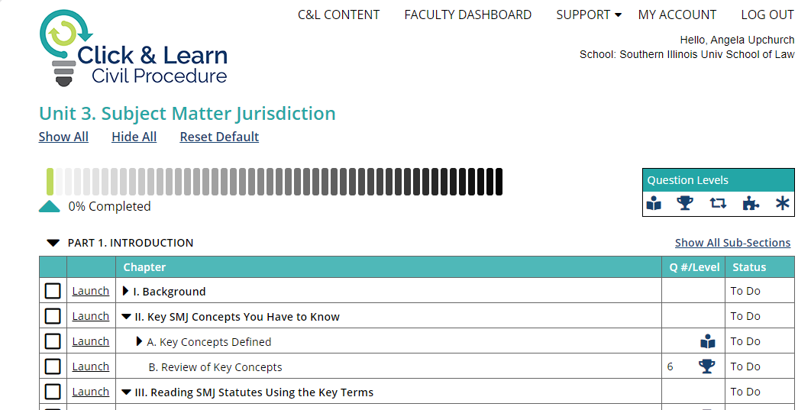
Division of C&L: Content Parts and Chapters
Notes:
This slide is just designed to show Unit v. Part v. Chapter and show divisions within that

Slide 11
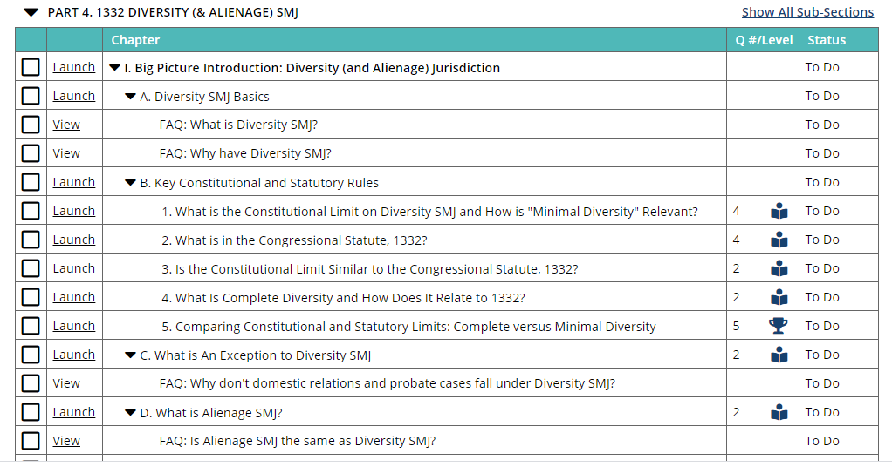
Basic Structure of Content
FAQs
Each concept is introduced through several interactive FAQs

Slide 12
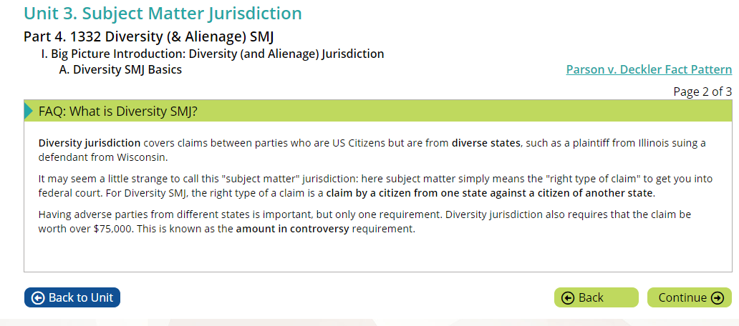
FAQ Example

Slide 13

Basic Structure of Content
After FAQ, students are then provided introductory questions (Reading and Understanding Questions)
Preview concepts
Work through typical points of confusion
Promote skills (e.g., rule, statutory, case reading)
Uses actual rules, statutes and cases (not just summaries) via links and pop-up boxes
Notes:
CMH note: I don’t think I’m following what are “actual documents.” When I read this I think of actual pleadings etc from a case. But, we don’t do that. Also, I’m confused how this is R&U. But, I assume I’m missing something? I wonder if this is actually about promoting skills and how they are linked to the actual rule.statute?
ANGELA note: I hope this is more clear with the revised language. While we do have a few case summaries, we tend to draw the student to the actual rule, statute or case language so that they are asked to develop their reading skills (as opposed to a typical hornbook or study aid). I think this is worth mentioning as a separate concept. For example, I think we do two different things that most books don’t: (1) we GIVE instruction on how to read these things and then test their ability to read; (2) we REINFORCE these skills by always taking the student to actual text when they need to find an answer. Both promote skills, but I think they are separate aspects of learning that we engage the student in (and to my knowledge isn’t done in any other supplement)

Slide 14
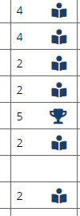
Basic Structure of Content
See level of question and # of questions from Table of Contents (and when setting required assignments)
Notes:
ANGELA NOTE: I added the extra zoomed in overlay and it will fly in when we want it. I thought it might be helpful to see the whole TOC and then see this zoom. If you want only the zoom, let me know.

Slide 15
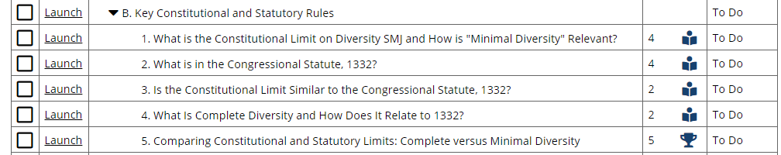
Basic Structure of Content
Advanced questions test the students’ understanding of civ pro concepts by asking them to apply the concept to a fact pattern
Practice Makes Perfect
Notes:
I thought we could show the progression from R/U to PMP here

Slide 16
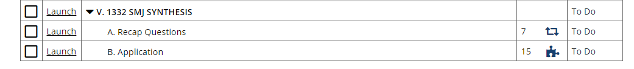
Basic Structure of Content
Synthesis questions review a larger concept or ask the student to integrate their understanding of multiple concepts
Most synthesis sections include several warm-up questions called “Recap questions”

Slide 17
Digging Deeper: Ways to incorporate C&L:CP
1
Turn-key, easy to integrate supplement
Test student understanding at the end of a topic by running higher-level application questions
Preview material outside of class by running basic introductory questions (which can also constitute ABA class minutes)
Enhance in-class learning by running higher-level application questions (or reviewing tricky concepts with basic questions), rather than writing your own
2
3
4
Notes:
I blended everyone’s comments and tried to simplify – please continue to edit
For our presentation, let’s just put these up and then go through them in more detail later. Here is the detail we will get into later, but if we get asked, I am including notes here: (NOTE – all can be done in group work or through group discussion online)
On #1: This is the easiest to go with option; You can recommend portions of C&L:CP for your students to complete on their own, at their own pace, to help them learn and reinforce concepts to achieve mastery; Use our casebook companion tables to create your assignments
On #2: Assign higher level questions at the end of a topic (or multiple topics) for review and/or assessment
On #3: Assign basic questions to have students preview or learn a concept before/outside of class time (either alone or in groups). Supports pre-recorded lectures. Can also be used to meet ABA minutes requirement for class
On #4: we can expand on ways to run a question in-class (polling options) or group work; also we can note how to select an appropriate question

Slide 18
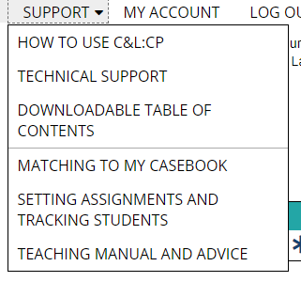
Recommending/Requiring Portions of C&L
Note the portions of C&L:CP that correspond with your casebook reading assignment
Make these sections optional OR require some/all questions
Notes:
Casebook matched available for Freer& Purdue; Glannon; Yeazell; Hess; Spencer
Can also use the Downloadable ToC in Excell as checklist for ANY case book

Slide 19
Digging Deeper: Ways to incorporate C&L:CP
1
Turn-key, easy to integrate supplement
Test student understanding at the end of a topic by running higher-level application questions
Preview material outside of class by running basic introductory questions (which can also constitute ABA class minutes)
Enhance in-class learning by running higher-level application questions (or reviewing tricky concepts with basic questions), rather than writing your own
2
3
4
Notes:
I blended everyone’s comments and tried to simplify – please continue to edit
For our presentation, let’s just put these up and then go through them in more detail later. Here is the detail we will get into later, but if we get asked, I am including notes here: (NOTE – all can be done in group work or through group discussion online)
On #1: This is the easiest to go with option; You can recommend portions of C&L:CP for your students to complete on their own, at their own pace, to help them learn and reinforce concepts to achieve mastery; Use our casebook companion tables to create your assignments
On #2: Assign higher level questions at the end of a topic (or multiple topics) for review and/or assessment
On #3: Assign basic questions to have students preview or learn a concept before/outside of class time (either alone or in groups). Supports pre-recorded lectures. Can also be used to meet ABA minutes requirement for class
On #4: we can expand on ways to run a question in-class (polling options) or group work; also we can note how to select an appropriate question

Slide 20
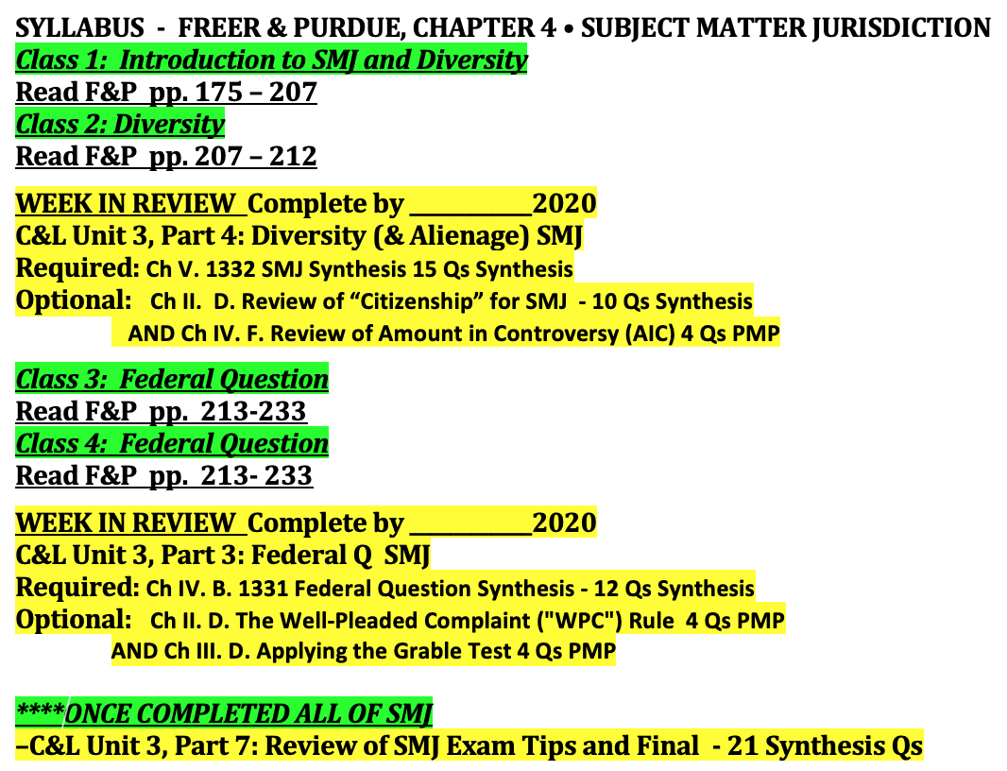
Syllabus Example
Notes:
This shows completing “modules” e.g., Diversity – usuall assignments in gren – then doing REIVEW fro C&L in yellow. Then Fed Q then REVIEW. Ect
The review is REQUIRING SYNTHESIS and OPTIONAL PMP?SYNTHESIS
Thiis is like Andy’s syllabus – only he assigned the entire Chapter

Slide 21
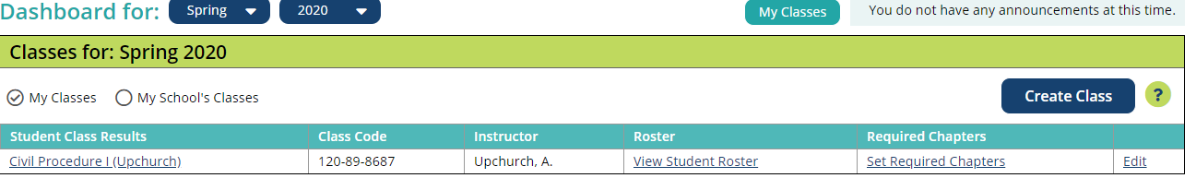
Assigning Questions
Notes:
NOTE: Talk about getting to the Dashboard and Set Requried Chapters first NOTE THIS IS ALL REPLICATED WITH DIAGRAMS IN SUPPORT
THEN…How to find the right questions (PMP and Synthesis) AND selecting due dates on next slide

Slide 22
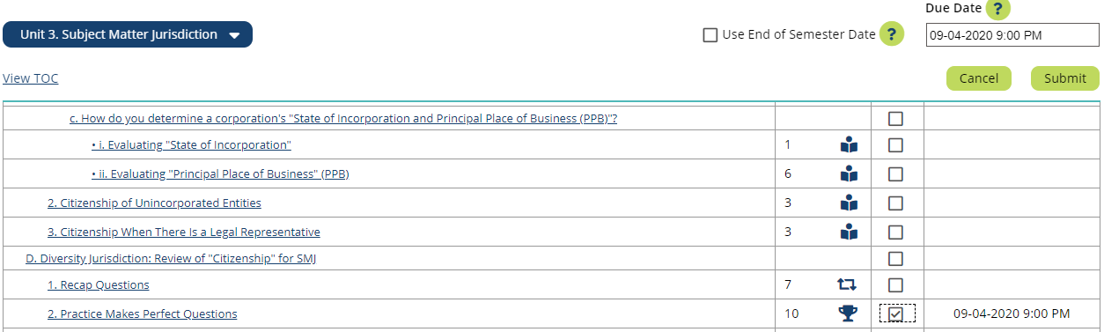
Assigning Questions
Notes:
NOTE: How to find the right questions (PMP and Synthesis) AND selecting due dates

Slide 23
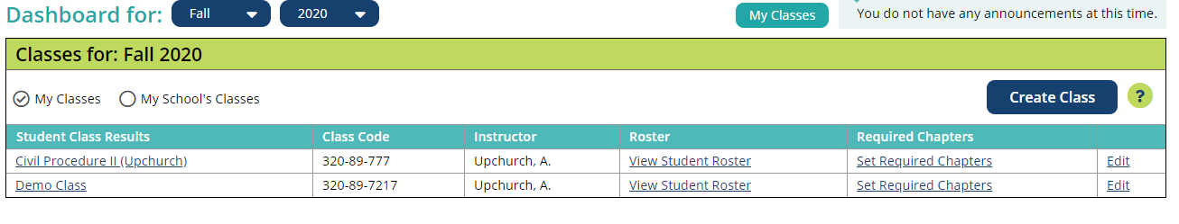
Want to know who is completing questions and how they are performing?

Slide 24
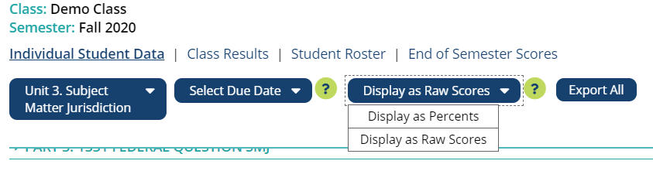
Want to know who is completing questions and how they are performing?
Notes:
Selection of options

Slide 25
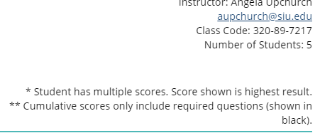
Want to know who is completing questions and how they are performing?
Notes:
Selection of options

Slide 26
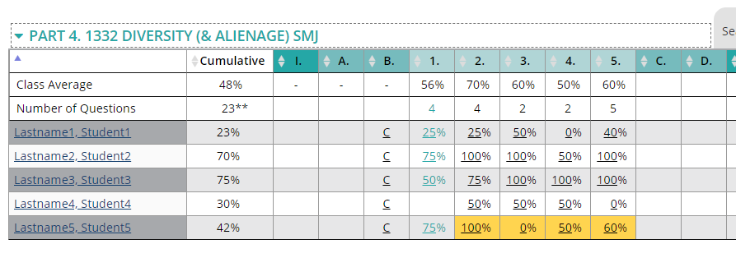
Want to know who is completing questions and how they are performing?
Notes:
Explain colors for late and optional. Also explain that you can see % or raw score (on next slide)

Slide 27
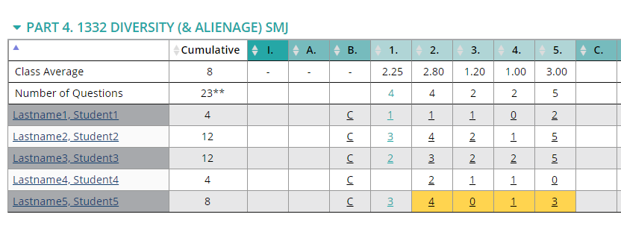
Want to know who is completing questions and how they are performing?
Notes:
Explain colors for late and optional. Also explain that you can see % or raw score (on next slide)

Slide 28
Digging Deeper: Ways to incorporate C&L:CP
1
Turn-key, easy to integrate supplement
Test student understanding at the end of a topic by running higher-level application questions
Preview material outside of class by running basic introductory questions (which can also constitute ABA class minutes)
Enhance in-class learning by running higher-level application questions (or reviewing tricky concepts with basic questions), rather than writing your own
2
3
4
Notes:
I blended everyone’s comments and tried to simplify – please continue to edit
For our presentation, let’s just put these up and then go through them in more detail later. Here is the detail we will get into later, but if we get asked, I am including notes here: (NOTE – all can be done in group work or through group discussion online)
On #1: This is the easiest to go with option; You can recommend portions of C&L:CP for your students to complete on their own, at their own pace, to help them learn and reinforce concepts to achieve mastery; Use our casebook companion tables to create your assignments
On #2: Assign higher level questions at the end of a topic (or multiple topics) for review and/or assessment
On #3: Assign basic questions to have students preview or learn a concept before/outside of class time (either alone or in groups). Supports pre-recorded lectures. Can also be used to meet ABA minutes requirement for class
On #4: we can expand on ways to run a question in-class (polling options) or group work; also we can note how to select an appropriate question

Slide 29
Preview and Supporting Learning Outside of Class
You can pair this with traditional casebook reading (and/or videos for online/hybrid learning)
Make this optional or required

Slide 30
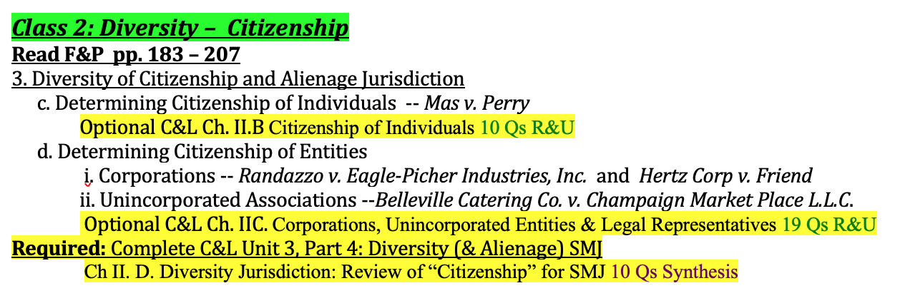
Syllabus Example: Review and Supporting Learning Outside of Class
Notes:
This is the edited version – it shows the R&U as optional pre-class preparation AND then the PMP as required pre-class

Slide 31
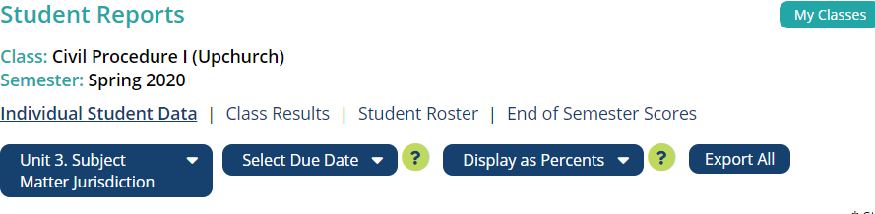
Use student data to inform your teaching

Slide 32
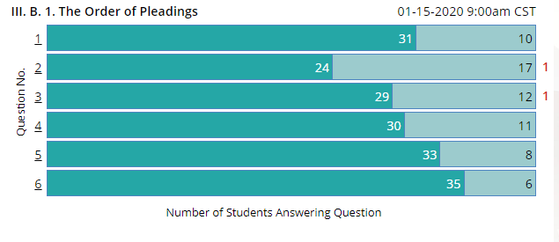

Use student data to inform your teaching

Slide 33
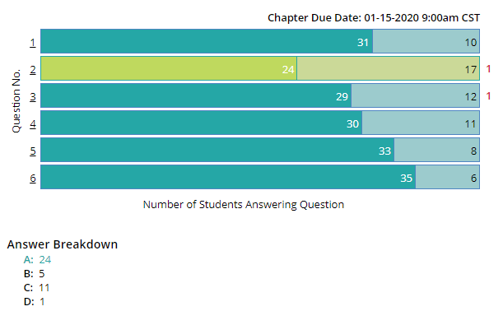
Use student data to inform your teaching

Slide 34
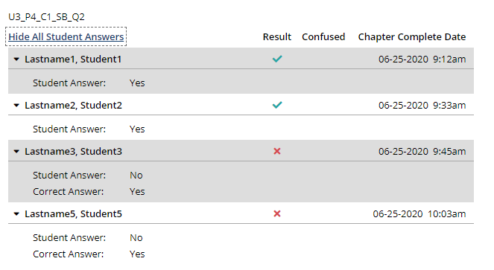
Use student data to inform your teaching

Slide 35
Preview: Ways to incorporate C&L:CP
1
Turn-key, easy to integrate supplement
Test student understanding at the end of a topic by running higher-level application questions
Preview material outside of class by running basic introductory questions (which can also constitute ABA class minutes)
Enhance in-class learning by running higher-level application questions (or reviewing tricky concepts with basic questions), rather than writing your own
2
3
4
Notes:
I blended everyone’s comments and tried to simplify – please continue to edit
For our presentation, let’s just put these up and then go through them in more detail later. Here is the detail we will get into later, but if we get asked, I am including notes here: (NOTE – all can be done in group work or through group discussion online)
On #1: This is the easiest to go with option; You can recommend portions of C&L:CP for your students to complete on their own, at their own pace, to help them learn and reinforce concepts to achieve mastery; Use our casebook companion tables to create your assignments
On #2: Assign higher level questions at the end of a topic (or multiple topics) for review and/or assessment
On #3: Assign basic questions to have students preview or learn a concept before/outside of class time (either alone or in groups). Supports pre-recorded lectures. Can also be used to meet ABA minutes requirement for class
On #4: we can expand on ways to run a question in-class (polling options) or group work; also we can note how to select an appropriate question

Slide 36
Enhance In-Class Learning: Cover questions in class to clarify points of student confusion or reinforce understanding
Display question that was assigned and students struggled with and cover together
Do a “mash-up” of questions, picking the parts the students struggled with and making your own variation
Save some higher-level questions (PMP or Synthesis) for in-class time
Run questions with polling software option (e.g., through TWEN, Zoom, Socrative or others) to see class wide responses
Have students discuss question in a group (in-person or remotely) and click in to see response
Notes:
ANGELA : I took out the discussion in “breakout rooms” because that is really through Zoom. We should definitely mention it, but there are a LOT of ways to do this remotely outside of Zoom. I would include message board discussions, Live Discussion chat rooms on TWEN, Marco Polo app, Socrative in student-led format etc.

Slide 37
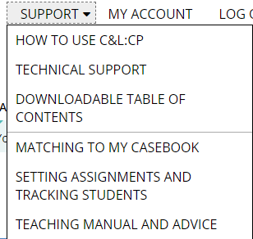
Additional Resources
Teacher’s Manual on “Support” Link
Table of contents in MS Word available
Can help with assignments
Note-taking templates to give your students which track TOC
Coming “How To” videos
Coming YouTube channel with basic videos
www.youtube.com/professorupchurch

Slide 38
Q & A
Contact info
Angela Upchurch aupchurch@siu.edu
Susan M. Gilles sgilles@law.capital.edu
Cynthia M. Ho cho@luc.edu

